Slide 1
操作系统作业五

Slide 2
0
Mutual exclusion:
No two processes could be simultaneously inside their critical sections.
Progress:
No process running outside its critical section should block other processes.
Bounded waiting
No process would have to wait forever in order to enter its critical section.

Slide 3
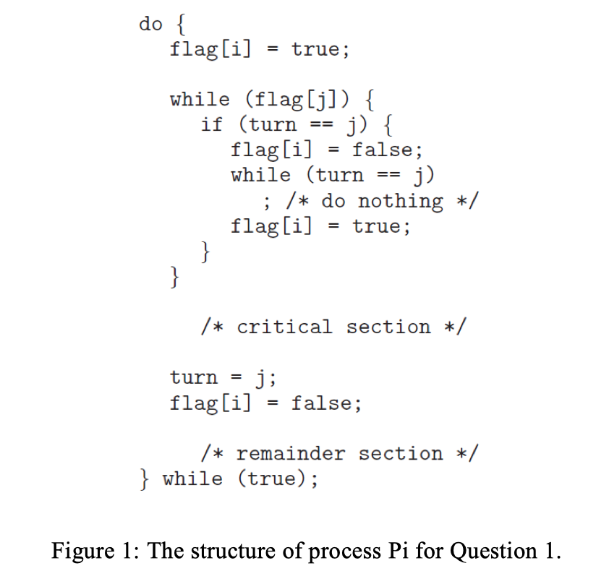
1
The first known correct software solution to the critical-section problem for two processes was developed by Dekker. Prove that the algorithm satisfies all three requirements for the critical-section problem.

Slide 4
1
Mutual exclusion:
If both processes set their flag to true, only one will succeed, namely, the process whose turn it is. The waiting process can only enter its critical section when the other process updates the value of turn.
Progress:
A process will set its flag to false right after leaving critical section, so it won’t block other processes.
Bounded waiting
A process will never wait longer than one turn for entrance to the critical section since the other process will set its flag and turn after leaving critical section.

Slide 5
2
Consider the code example for allocating and releasing processes shown in Figure 2.
Identify the race condition(s).
Assume you have a mutex lock named mutex with the operations acquire() and release(). Indicate where the locking needs to be placed to prevent the race condition(s).

Slide 6
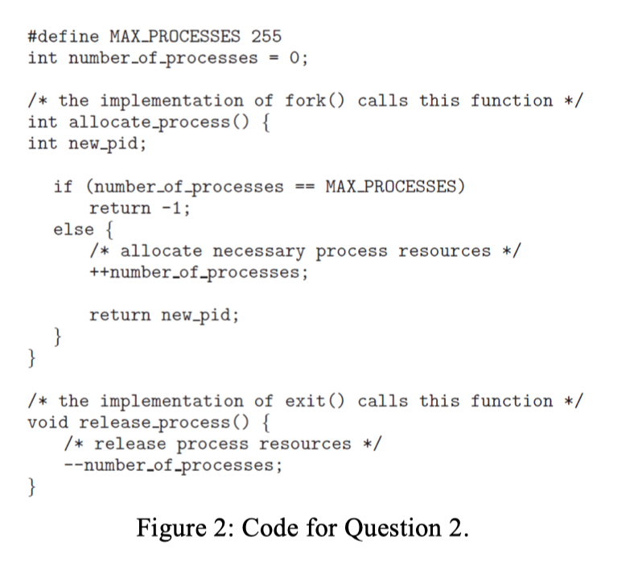
2

Slide 7
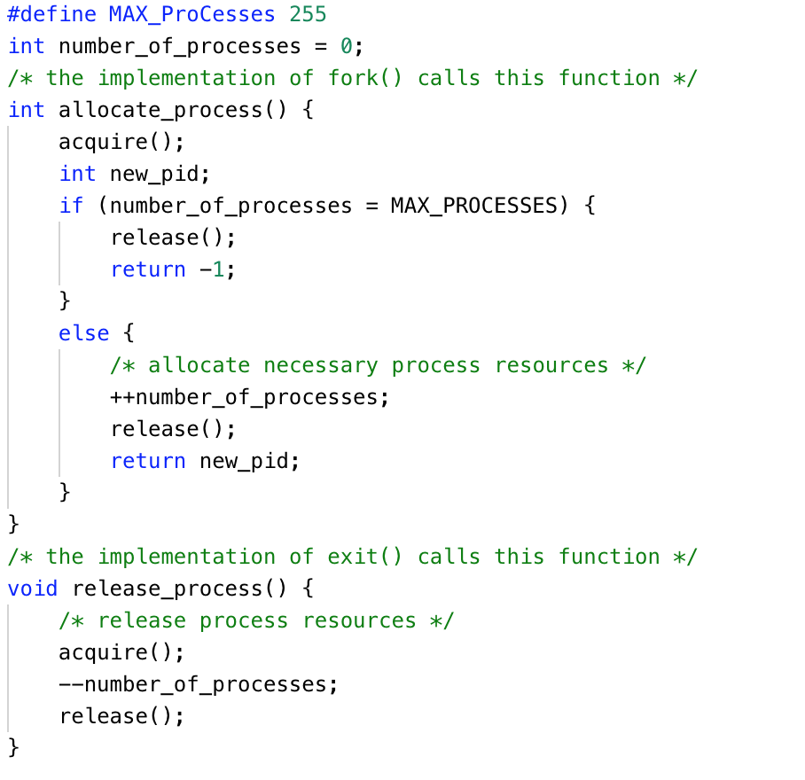
2
There is a race condition on the variable number of processes.

Slide 8
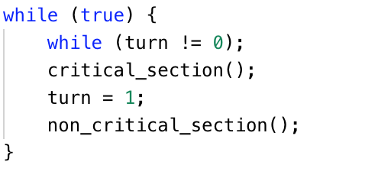
3
Strict alternation

Slide 9
3
Can strict alternation and Peterson’s solution satisfy all the requirements as a solution of the critical-section problem? Please explain why.
Strict alternation violate requirement #3: no process running outside its critical section should block other processes.
Process 0 leaves its critical region and sets turn to 1, enters its non critical region.
Process 1 enters its critical region, sets turn to 0 and leaves its critical region.
Process 1 enters its non-critical region, quickly finishes its job and goes back to the while loop. Since turn is 0, process 1 has to wait for process 0 to finish its non-critical region so that it can enter its critical region.

Slide 10
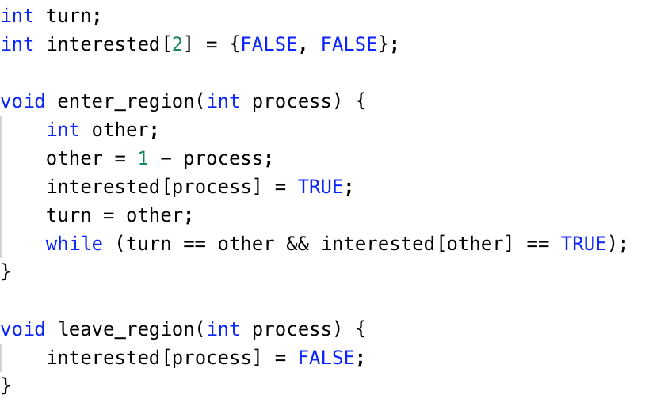
3
Peterson’s solution satisfy all the requirements.

Slide 11
3
Mutual exclusion:
P0 and P1 can never be in the critical section at the same time: If P0 is in its critical section, then interested[0] is true. In addition, either interested[1] is false, or turn is 0, or P1 is trying to enter its critical section, after setting interested[1] to true but before setting turn to 0 and busy waiting. So if both processes are in their critical sections then we conclude that the state must satisfy and turn = 0 and turn = 1.

Slide 12
3
Progress:
A process will set its interested to false right after leaving critical section, so it won’t block other processes.
Bounded waiting:
In Peterson's algorithm, a process will never wait longer than one turn for entrance to the critical section.

Slide 13
4
What are the key idea and the cons of the Peterson’s solution?
Key idea:
Share two data items
int turn; // whose turn to enter its critical section
boolean interested[2]; // if a process wants to enter
Processes would act as a gentleman: the process always let another process to enter the critical region first although it wants to enter too.
No alternation is there

Slide 14
4
Cons:
Busy waiting has its own problem:
wasting CPU time
priority inversion problem

Slide 15
5
What is semaphore? How to use semaphore to implement section entry and section exit (no busy waiting)? Please give the code.
Semaphore is a data type (additional shared object)
Accessed only through two standard atomic operations
down(): originally termed P (from Dutch proberen, “to test”), wait() in textbook
Decrementing the count
up(): originally termed V (from verhogen, “to increment”), signal() in textbook
Incrementing the count

Slide 16
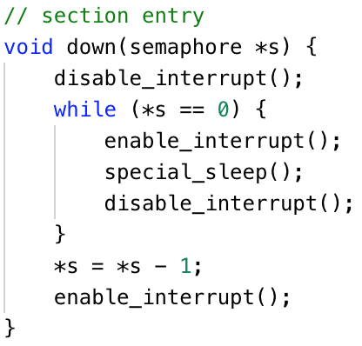
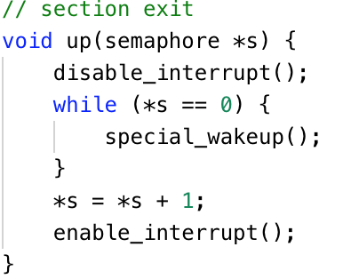
5

